Slide 1
Immutable.js

Slide 2
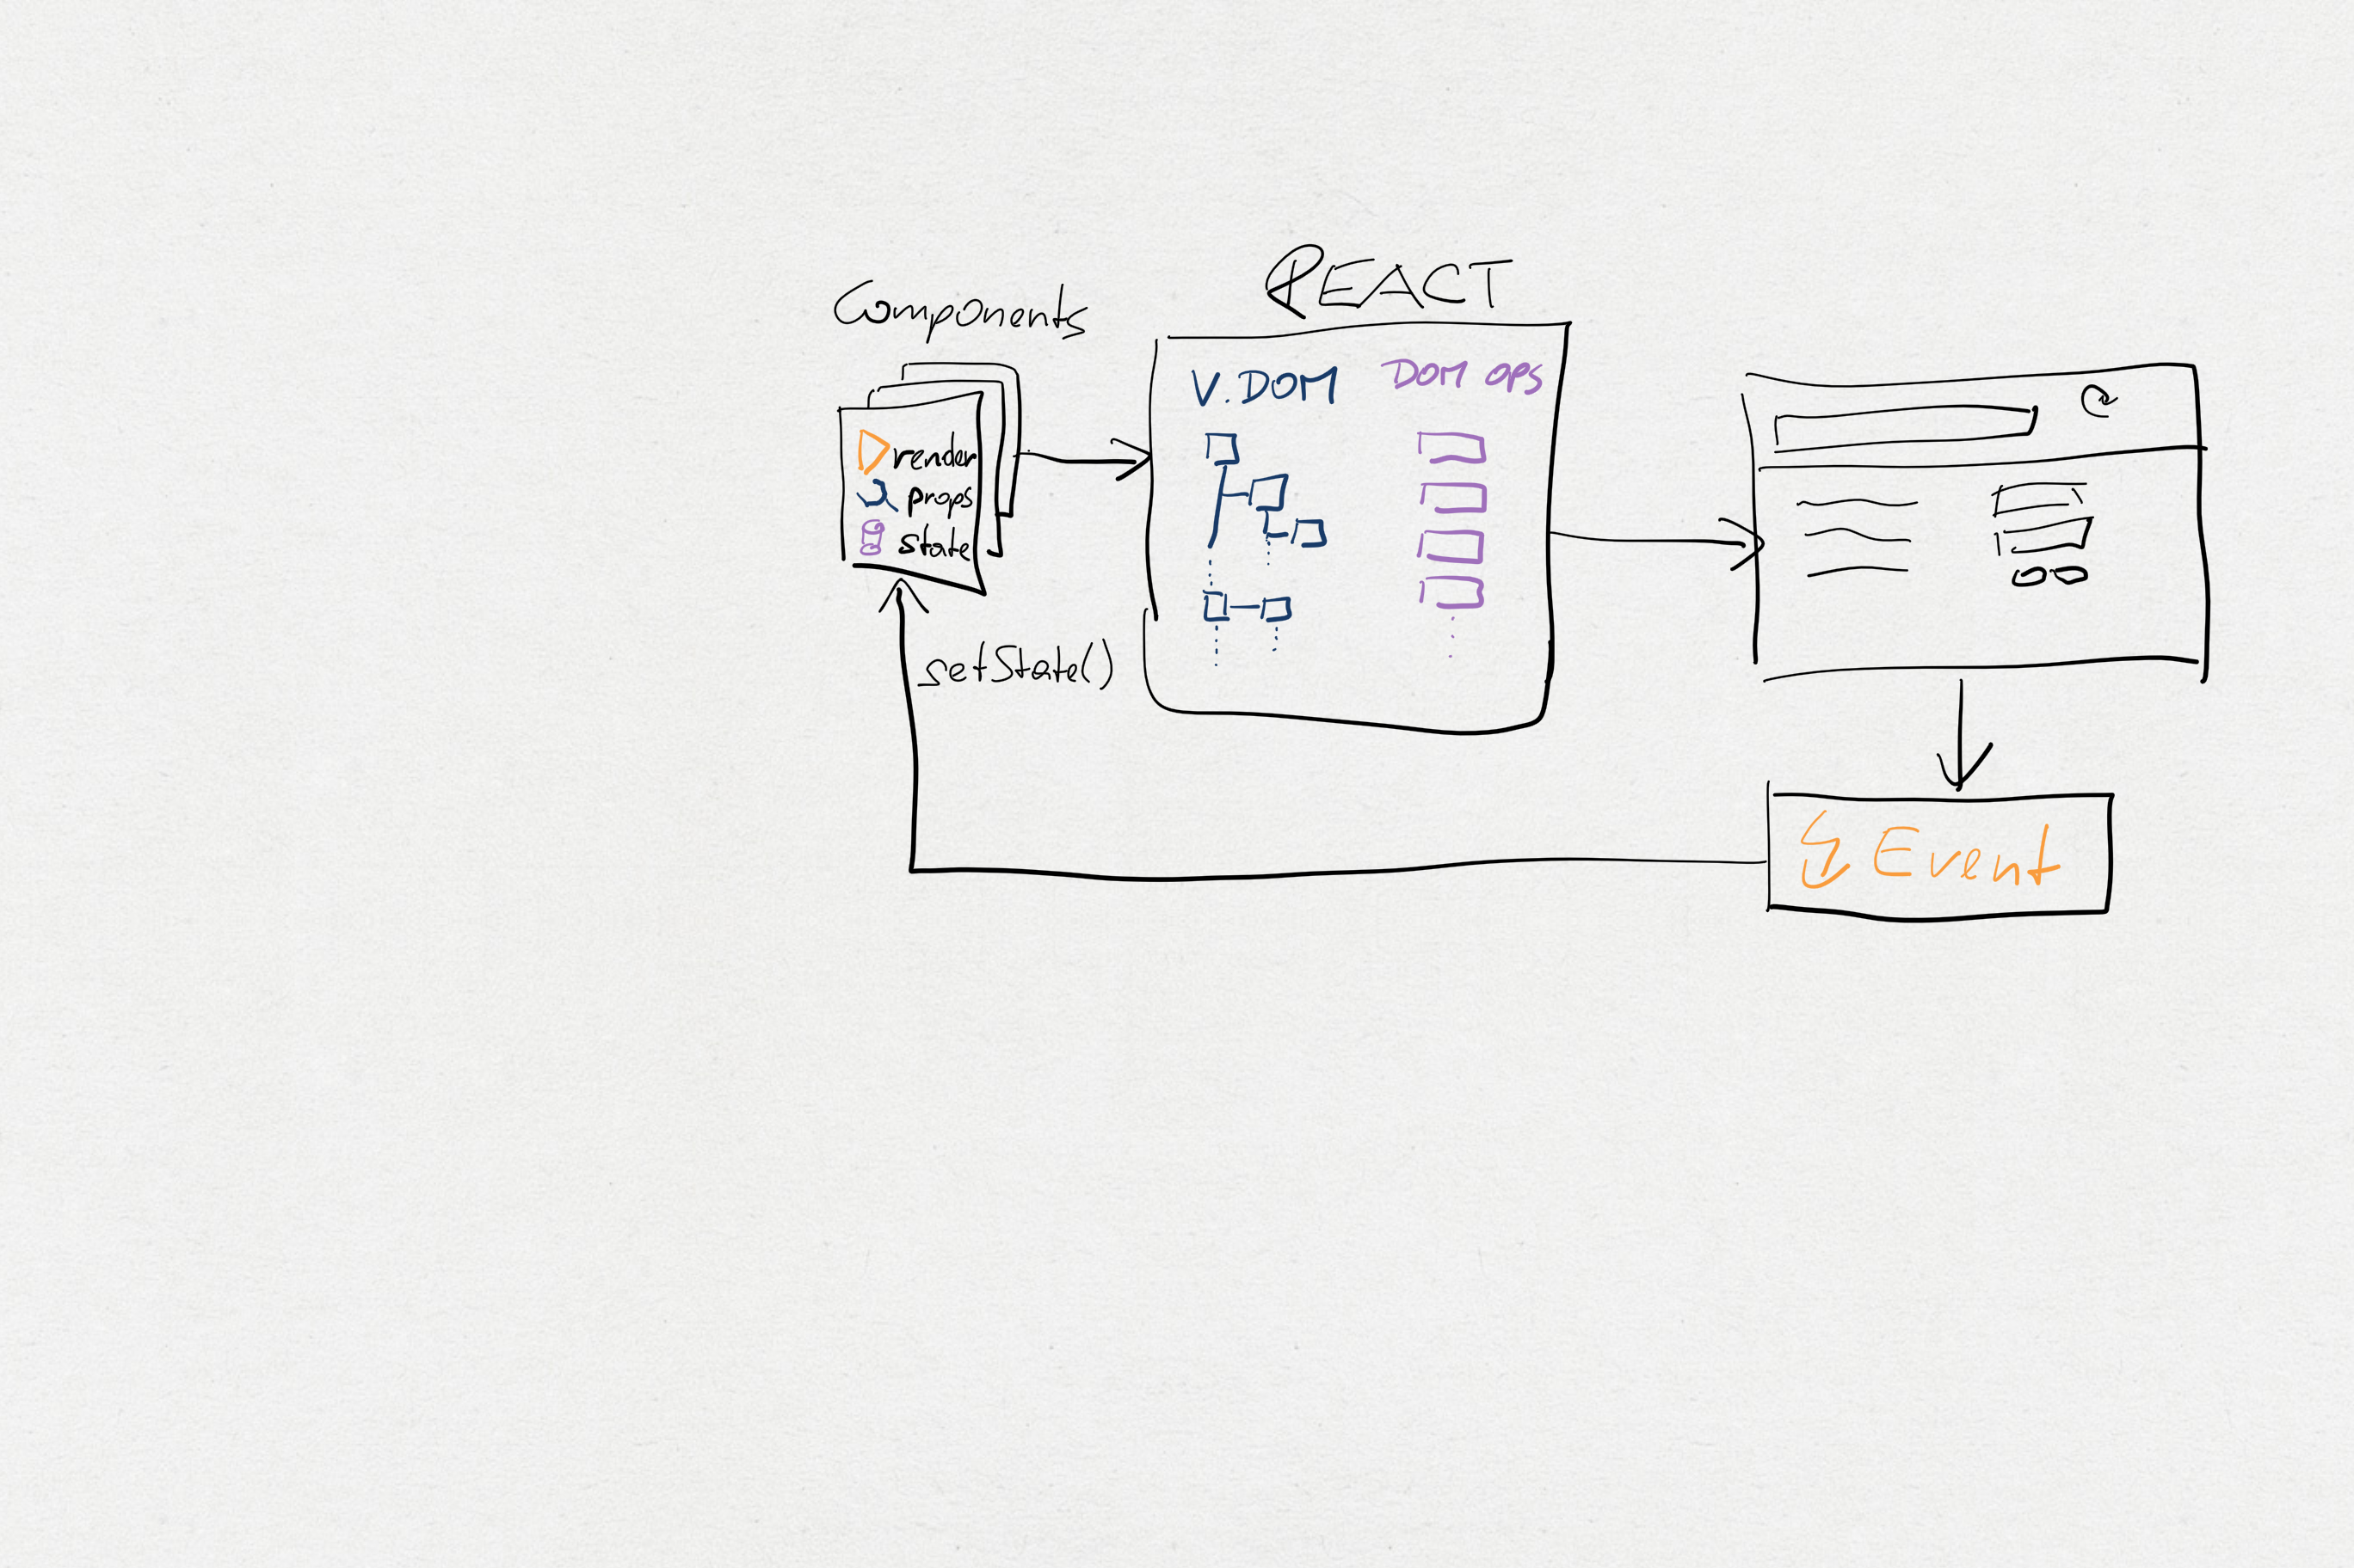

Slide 3
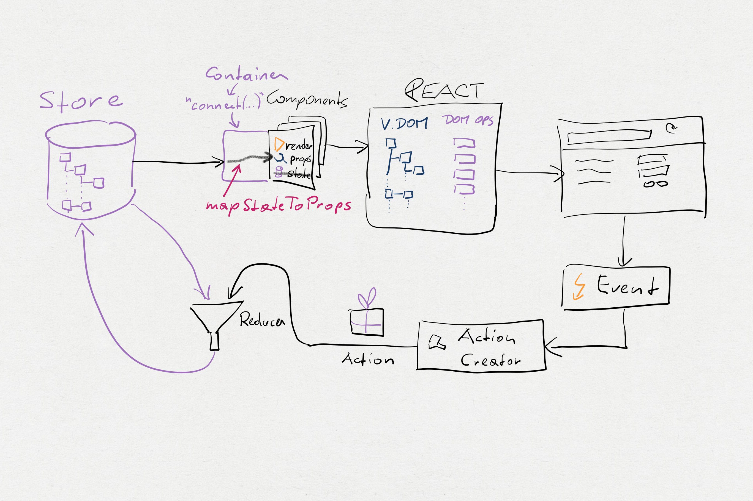

Slide 4
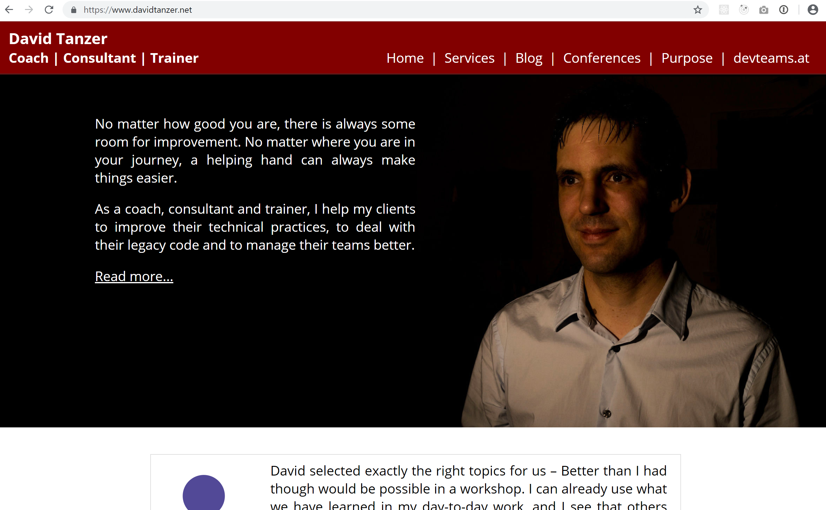
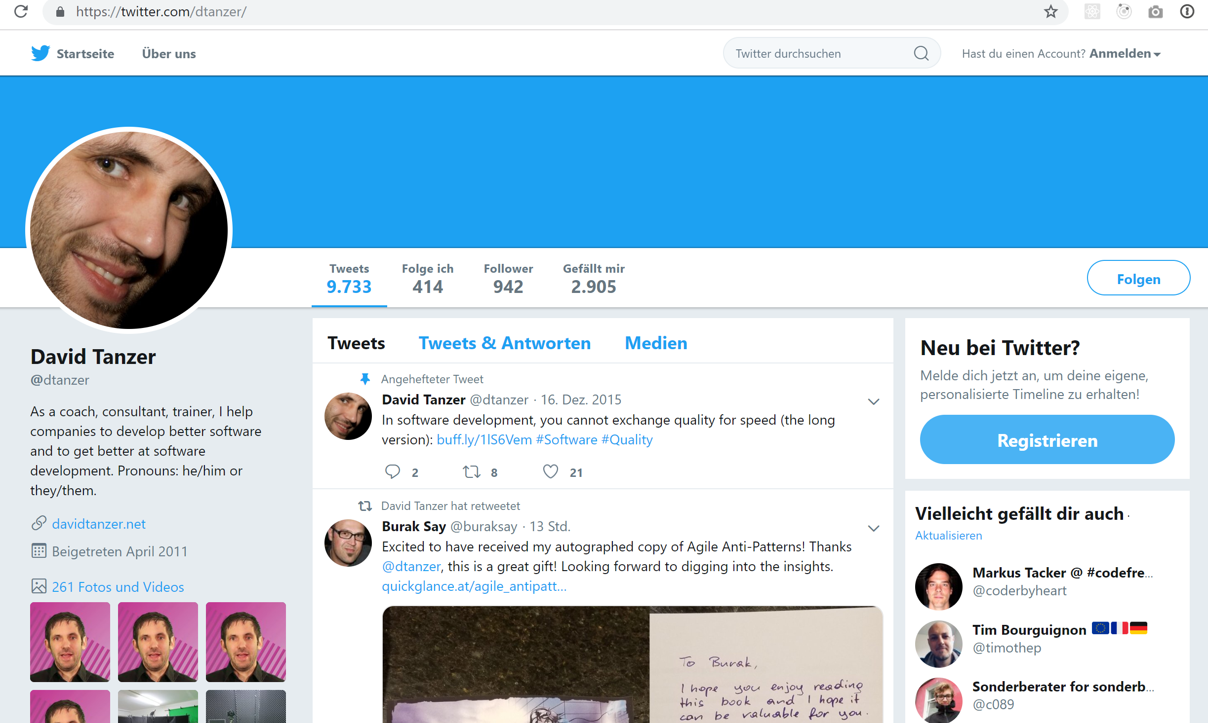
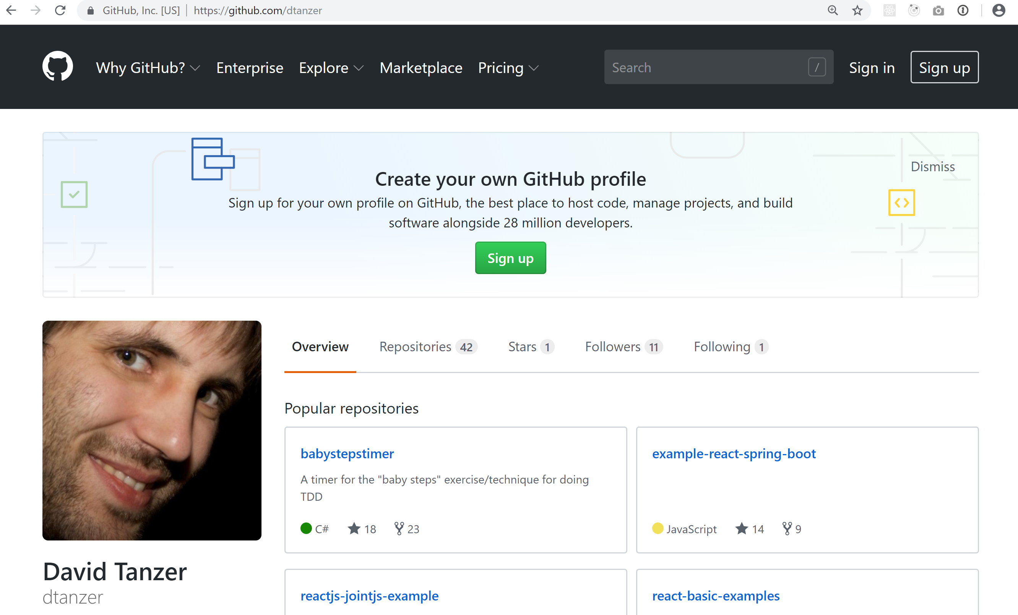
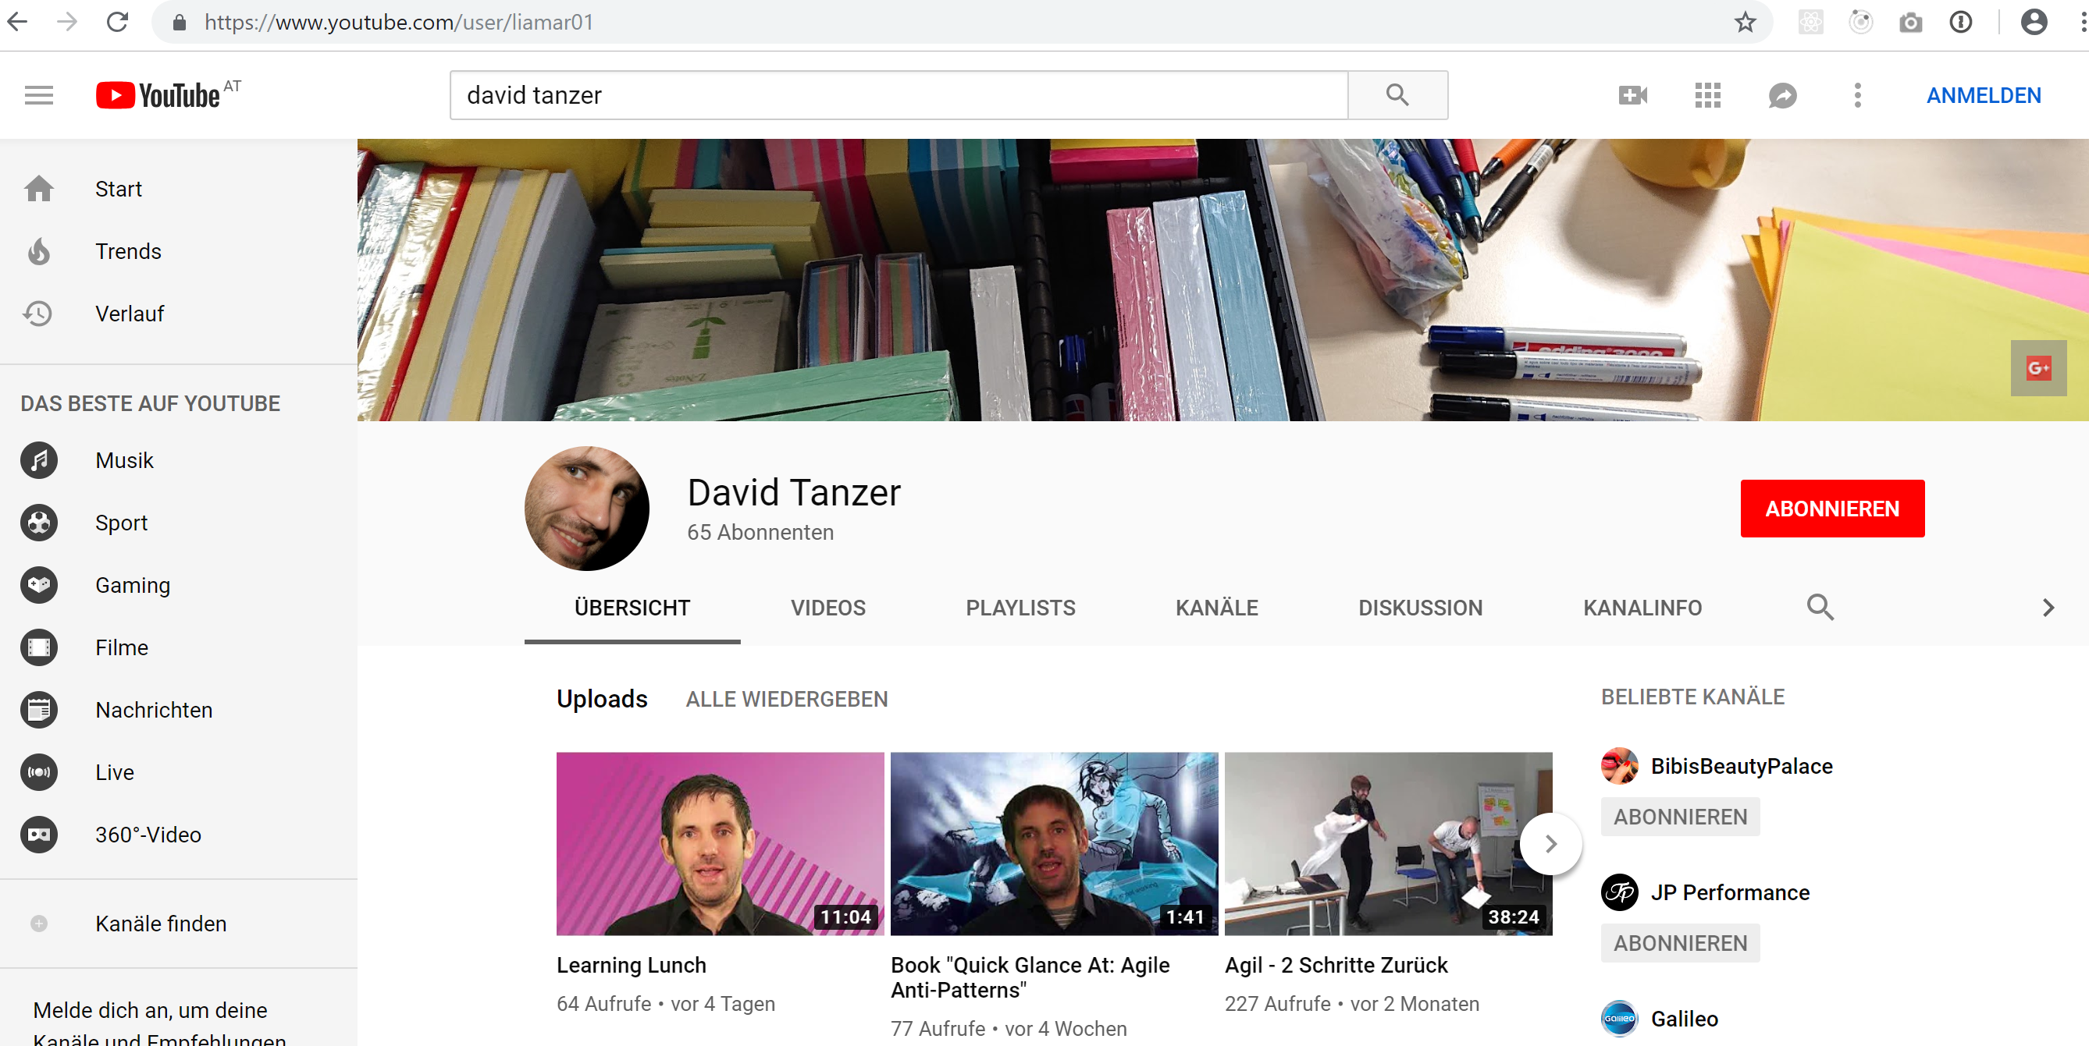
www.davidtanzer.net
@dtanzer
dtanzer
David Tanzer

Slide 5

https://socrates-conference.at/ Discount Code: stahlstadtNaN19

